Slide 1
Spectroscopy “A Picture is Worth a Thousand Words. A Spectrum is Worth a Thousand Pictures.”

Slide 2
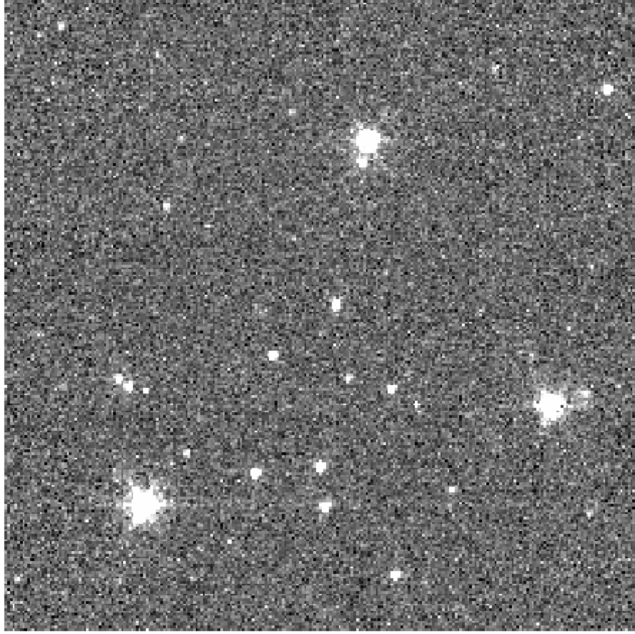
Imaging vs. Spectroscopy
Imaging
Spectroscopy
Brightness—HR diagram lab
Position—Pluto lab
Morphology—is the galaxy a spiral or an elliptical?
Color (>1 wavelength)—is the star red or blue?
Atomic and molecular compositions
Ionization states (temperature and density)
Kinematics (redshift / Doppler radial velocity)

Slide 3
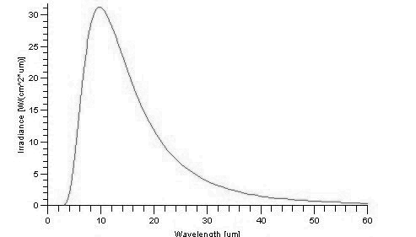
Kirchoff’s Laws of Spectroscopy
“A solid, liquid, or dense gas excited to emit light will radiate at all wavelengths and thus produce a continuous spectrum.”
“A low-density gas excited to emit light will do so at specific wavelengths and this produces an emission spectrum.”
“If light composing a continuous spectrum passes through a cool, low-density gas, the result will be an absorption spectrum.”

Slide 4
How Spectrographs Work I: Put a Prism in Your Imager

Slide 5
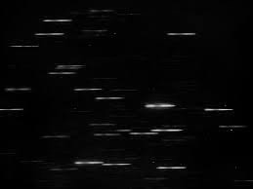
How Spectrographs Work I: Put a Prism in Your Imager
(keep in mind that astronomical CCDs don’t register color)

Slide 6
How Spectrographs Work I: Put a Prism in Your Imager
Some spectra overlap, especially if you have longer spectra (more wavelengths)
Use a slit to isolate one source

Slide 7
How Spectrographs Work I: Use a Slit to Isolate One Source
Normal Image
Insert Slit
Insert Prism

Slide 8
Prism Spectrograph
CCD

Slide 9
Grating Spectrograph (More Common)

Slide 10
Multi-Object Spectrograph

Slide 11
Integral Field Spectrograph (what Andy builds, so you have to hear about it)

Slide 12
Integral Field Spectrograph (what Andy builds, so you have to hear about it)

Slide 13
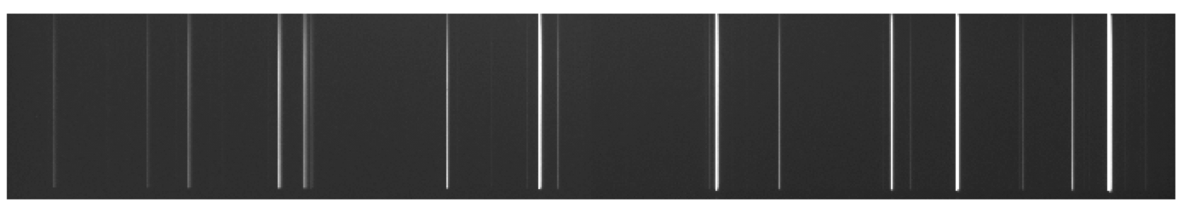
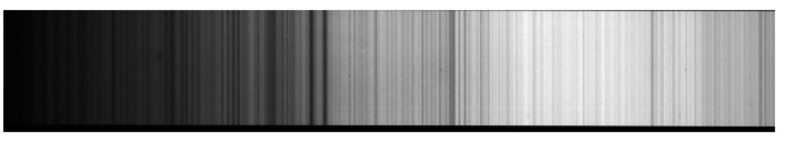
Today: Identify Absorption Lines in Solar Spectrum
Arc-lamp for Wavelength Calibration
Solar Spectrum

Slide 14
Today: Identify Absorption Lines in Solar Spectrum
Use the arc-lamp spectrum to calibrate the wavelength vs. x-pixel of the detector
Extract the Solar spectrum. Plot brightness vs. wavelength
Identify as many Fraunhofer lines as you can
How would you identify the “spectral fingerprint” of Calcium in a galaxy of unknown redshift?

